Slide 1
Using multiple sources of evidence to identify causal mechanisms and influence programs
Jo Durham
Notes:
What I’m going to present is an evaluation approach which was applied to an existing development program in Lao PDR

Slide 2
Presentation overview
Methodological framework
The evaluation
The program
Evaluation question
Methods
Evaluation results & influence
Reflection on methodological framework

Slide 3
Methodological framework

Slide 4
Methodological framework
The combination of participant reasoning and program resources enables programs to ‘work’ (program ‘mechanism’)
Mechanisms can work at different levels
The contexts in which programs operate make a difference to the outcomes they achieve

Slide 5
Methodological framework
Household livelihood strategies are influenced by access to livelihood resources:
Skills, education, knowledge, labour, health (human)
Social contacts, networks relationships (social)
Safe drinking water, roads, equipment (physical)
Credit, savings (finance)
Land, forest, water (natural)

Slide 6
Methodological framework
Livelihood choices and outcomes are influenced by context:
Individual
Family
Community
Program
Broader community
The interaction between the program, its resources, the program recipient and the context determines program recipient choice and outcomes

Slide 7
The program

Slide 8
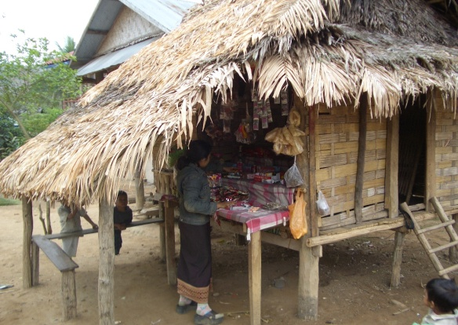
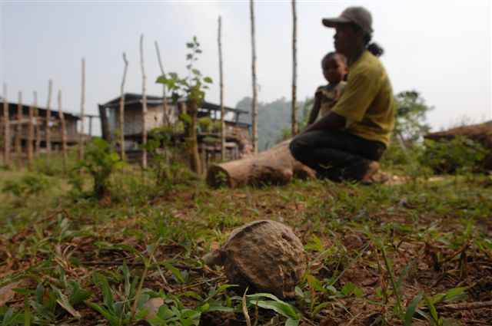
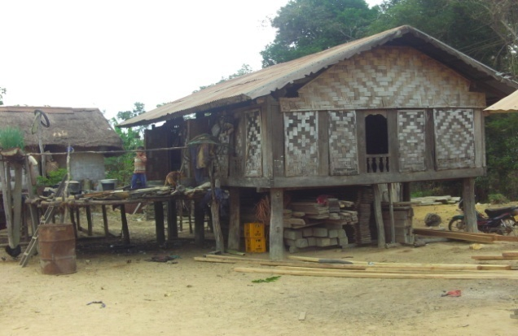
Lao PDR national program – removes unexploded ordnance (UXO) (e.g. grenades, rockets, and cluster munitions, bombs) from contaminated land
Generally remote, rural areas
Mainly subsistence farmers
Limited integration into cash economy
Limited access to basic services
Low literacy/education
No pre-intervention baseline, different service providers

Slide 9
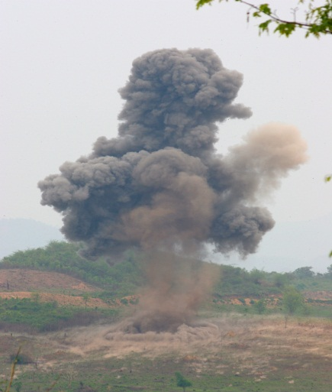
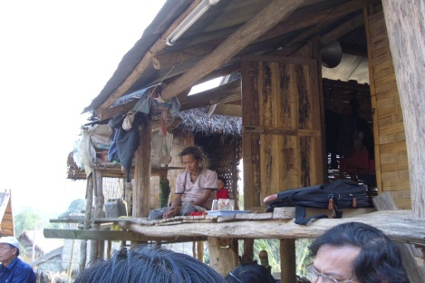
Unexploded ordnance (UXO)program in the Lao PDR
Program objective:
To reduce risk of post-conflict UXO injury and contribute to poverty reduction through removing UXO contamination from community and household land

Slide 10
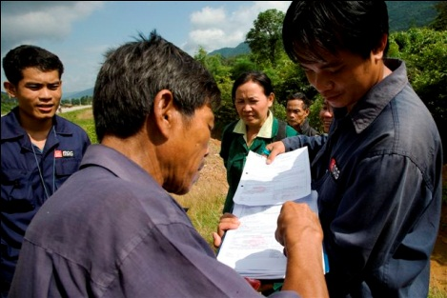
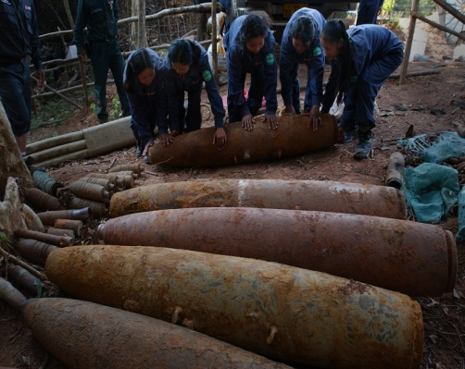
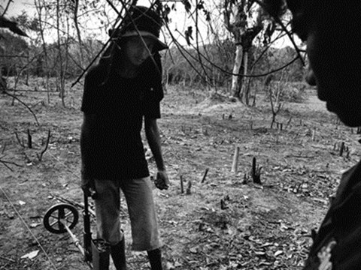
Evaluation context: Unexploded ordnance program in the Lao PDR
Program activities:
Survey, community engagement, identification of hazardous areas and removal and destruction of unexploded ordnance
Program recipients - households /community (particular focus on the poor)

Slide 11
Program logic
Longer term outcomes: land use contributes to improved livelihood outcomes (increased food security, access to infrastructure, health, income)
Outcome: land used by community/household (farming, wells, rehabilitation/upgrade of local infrastructure
Output: decontaminated land released to community /household
Activities: survey, community engagement to identify contaminated areas and where UXO is poses a barrier to productive land use (focus on poor), UXO removal, post-clearance handover of land
Rationale: UXO contamination restricts access to livelihood assets and prevents affected communities/households escaping poverty and achieving sustainable livelihoods

Slide 12
Evaluation question

Slide 13
Evaluation question
‘Who benefits, in what ways, and in what contexts are livelihoods affected by the removal of unexploded ordnance?’
Notes:
Realist method

Slide 14
Hypothesis
Data collection
Data analysis
Check /refine theory
Observation, discussion practitioners, literature
Revision/refine initial hypothesis
Mixed methods
Search for outcome patterns and context

Slide 15
Initial hypothesis: Two possible mechanisms (household level)
Engagement mechanism (before, during and post land clearance)
Incentive mechanism
Notes:
Remember the engagement mechanism is made up of two components – the resource (engagement strategy) + reasoning (cognitive process – interest)

Slide 16
Engagement mechanism
Engagement (before UXO land clearance) - raises awareness of intervention and households request clearance
Engagement (during UXO/post-UXO land clearance) – recipient aware of area of land cleared, confident in the process - sense of safety and land use

Slide 17
Incentive mechanism
UXO-free land provides an incentive for households to use the land in more effective ways to improve livelihood outcomes

Slide 18
Findings When does the engagement mechanism work? How? In what contexts? For who?
Notes:
Engagement (before UXO land clearance) - raises awareness of intervention and households request clearance

Slide 19
Engagement mechanism works when
Inclusive
Appropriate medium
Appropriate time
Sustained
Source is trusted
Works by raising awareness, creating interest and demand for service
Notes:
Remember the engagement mechanism is made up of two components – the resource (engagement strategy) + reasoning (cognitive process – interest) = request
Cognitive process facilitated by engagement strategy (what program provides)

Slide 20
Engagement mechanism works in the context of
Household context
Ability to understand process
Time to be involved in
engagement process
Have labour
Confident in program
Social/political connections
Believe will contribute to
livelihood goals
Program context
Bureaucracy
Organisational professionalism
Demarcating users
Notes:
livelihood goals may include safety and may be different to goals of program

Slide 21
Examples of when the engagement mechanism did not work
Cognitive:
Unaware of the service
Misinformed about eligibility (e.g. not sure if had to pay, throught their land too small)
Misinformed about the process – thought were on the list

Slide 22
Examples of when the engagement mechanism did not work
Household context:
Low priority – focus on meeting daily food requirements
Low priority – have strategies for managing the risk
Lack of assets (e.g. labour for vegetation removal)
Unable to complete forms (e.g. illiterate, embarrassed to ask for help)
Easier for households with assets (labour, literacy, social/political connections, basic needs met)
Notes:
Perpetuate status quo and reinforce existing power relations and inequalities

Slide 23
Implications for program
Need to strengthen engagement strategies including:
Staff training for staff
Multiple engagement strategies
Appropriate language and medium
Have and communicate clear criteria for eligibility
Simple request process
Monitor participation/engagement

Slide 24
Findings When does the incentive mechanism work? How? In what contexts? For who?
Notes:
Now we will look at the second mechanism. You might remember that this also consists of two components – resource (UXO-free land) and reasoning (believe using the UXO free land will contribute to livelihoods and they have the skill to use the land effectively) = land use (assuming during/post UXO clearance engagement mechanism has worked)

Slide 25
Incentive mechanism works when
Believe have ability to undertake planned action
Believe the planned action will contribute to livelihood goals
Believe that land has been cleared of UXO to satisfactory standard
Notes:
If believes are reinforced through experience change is more likely to be sustained (feedback loop)

Slide 26
Incentive mechanism works in the context of
Household context
Access to assets
Sense of ownership
Bureaucracy (timing/engagement)
Program context
Bureaucracy
Organisational professionalism
Notes:
Timing – e.g. during planting season, quality e.g. metal in with rice

Slide 27
Examples of when the incentive mechanism did not work
Cognitive:
Lack of ownership (engagement?)
UXO found on cleared land (quality of clearance or engagement?)
No plan to change land use

Slide 28
Examples of when the incentive mechanism did not work
Household context
Increased value – sold, redistributed, leased (rare)
Believe do not have skills/knowledge (e.g. switch to cash crops)
Unsure in effectiveness of different methods
Negative past experience (e.g. grow bananas but cannot sell)
Lack of access to assets (labour, skills, knowledge, literacy, equipment, seeds, markets)
Low priority - focus on meeting basic needs in proven way
No monitoring (policing)

Slide 29
Implications for program
Effective engagement
Work with community – widen ownership
Work with community – increase community efficacy/diffusion of innovation
Link communities with other service providers

Slide 30
One resource can lead to another
Notes:
Starting a chain of other mechanisms

Slide 31
Small cash income
Mediated by policies, institutions, markets, social/cultural norms, climate
Sell labour
Better access information, e.g. health and education
Have goods to sell & knowledge of market & believe to be beneficial
Labour market & saleable skills & believe to be beneficial
Buyers come
into the village
Effective engagement strategy before UXO clearance
Aware/ interested
& have assets & believe to be beneficial
Request UXO
land clearance
& HH has labour
& effective
engagement
Land UXO cleared
& have assets & believe to be beneficial
& trust quality
All weather road built safely & maintained
Notes:
Using the elements of realist evaluation the research identified how program resources can lead to other outcomes which in turn require other mechanisms. The context always influences outcomes.

Slide 32
Reflections on methods

Slide 33
Reflections on methodological framework
Helped highlight:
Who benefited
Helped explain outcomes
It recognised the importance of people in the evaluation
Highlighted where the program could intervene
Built on what program staff already knew (logical frameworks)
Worked well in a context where no baseline was available

Slide 34
Reflections on methodological framework
Qualitative methods essential in exploring mechanisms and contexts
Need for language to be adapted for audience
Raised issues of how different outcomes are valued & tensions between expected outcomes and reported outcomes for target group

Slide 35
Acknowledgements
MAG (Mines Advisory Group)
NRA (National Regulatory Authority for the UXO sector Lao PDR
Vong Nanhthavong, Co-researcher
Respondents
Photos courtesy of MAG

Slide 36
References
Pawson, R., & Tilley, N. (1997). Realistic Evaluation. London: Sage Publications.
Sayer, A. (2000). Realism and Social Science. London: Sage.

